Slide 1


Lecture No. 13 PHILOSOPHY OF HISTORY

Slide 2
1. History as a Subject of Philosophical Comprehension

Slide 3
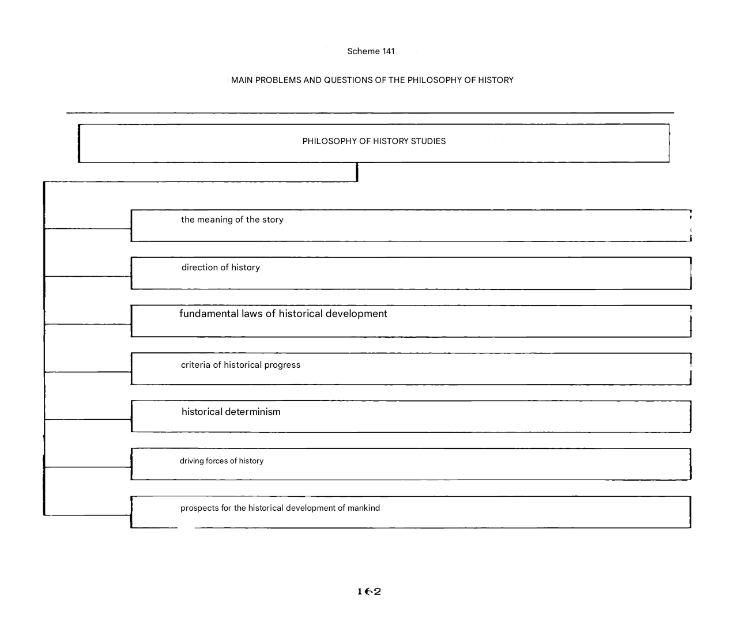

Slide 4
The word "history" in everyday speech denotes any change and development, and the term "history" denotes changes in society from the moment of its emergence.
The first historian is considered to be the ancient Greek Herodotus (V century BC) - "the father of history". Other famous ancient historians are Thucydides (5th century B.C.), Polybius (2nd century B.C.) and others, however, the Italian philosopher D. Vico (1668-1744) was the first to make a philosophical understanding of history:
he considered history as a process in which people create systems of languages, customs, laws, and social institutions. According to Vico, there are certain periods in history that have common features and are repeated in other periods. Similar periods tend to alternate in the same order. Philosophy of history is a philosophical interpretation of the historical process.
The term "philosophy of history" was first used by the French. thinker of the Enlightenment F. Voltaire. However, the idea of the unity and regularity of the historical process, in which all peoples are involved, was put forward by the German enlightener of the XVIII century J. Herder ("Ideas for the Philosophy of the History of Mankind" (1784)).

Slide 5
The historical process is an infinite variety, kaleidoscope and uniqueness of historical events. All of them took place in a certain space and time, i.e. social space and social time. Philosophical comprehension of the historical process took shape in three concepts of the development of history:
unilinear development; multilinear development; cyclic development.

Slide 6
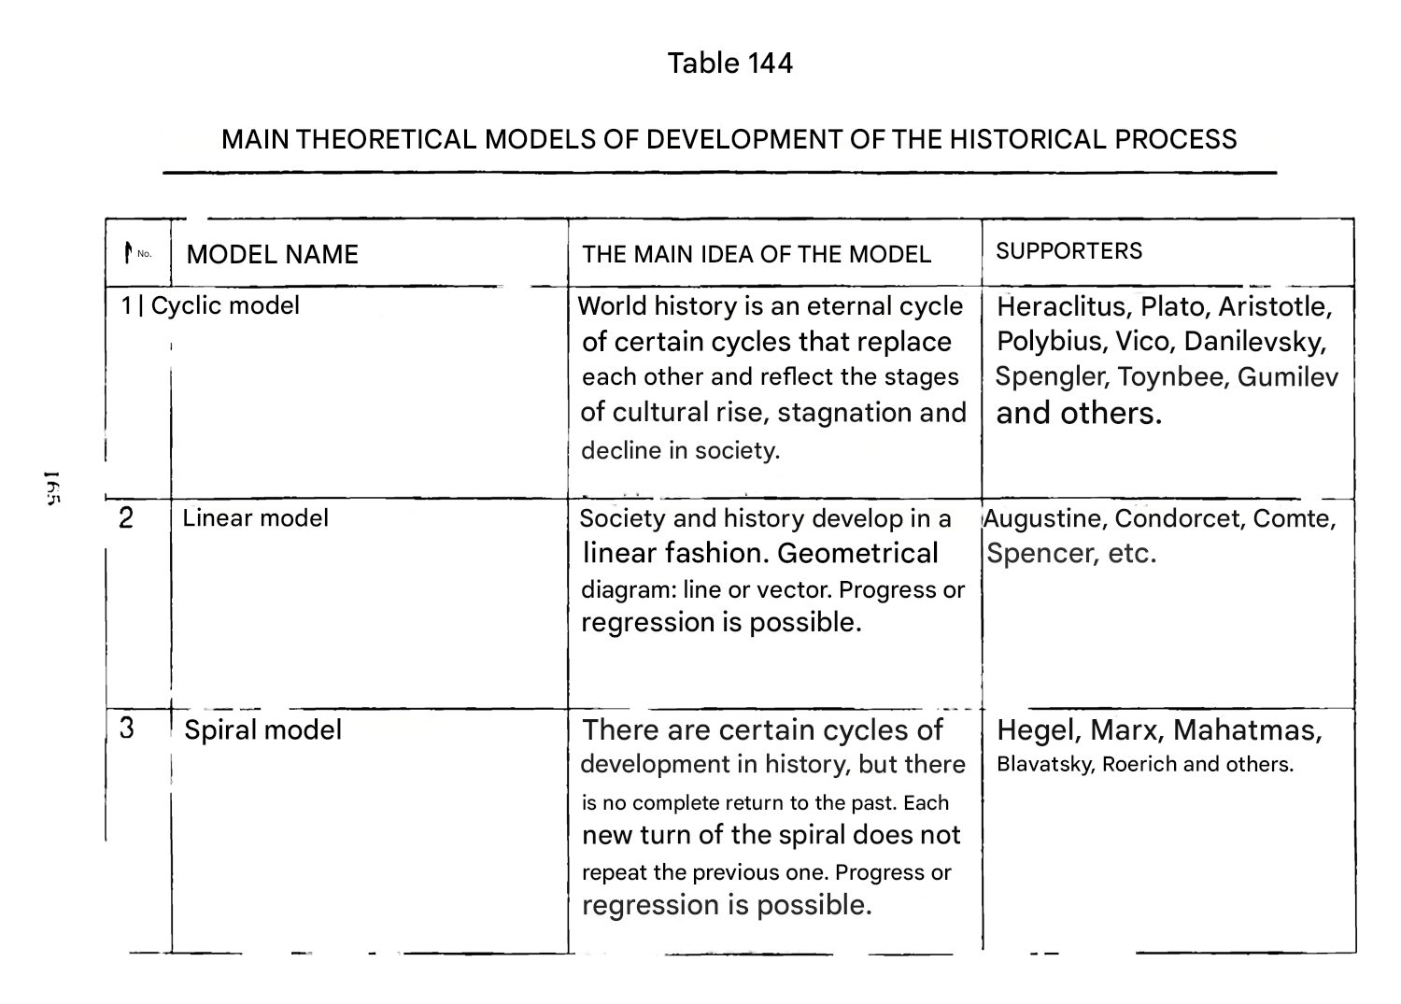

Slide 7
1. Unilinear development - defends the idea of the presence in history: first, internal logic; secondly, a special sacred meaning for everything that happens; thirdly, the ultimate goal. At the same time, the unilinear understanding of history is not homogeneous. It has several approaches to explaining the historical process:
The Christian understanding of history as an epoch of maturation, the perfection of mankind, guided by God; the process of movement of society from its creation by God to the Day of Judgment, i.e. the second coming of Christ (A. Blessed). History is characterized by: irreversibility; the uniqueness of each event.
The change of generations is the process of the entry of the temporal world into the eternal world;

Slide 8
According to Hegel, in history there is an objective spirit, the Universal Mind, which gradually unfolds and directs the activity of people. The goal of world history is the knowledge of the World Spirit itself, which is expressed in the spirit of each nation and cannot rest until it knows what it is. The criterion of this development is the consciousness of freedom. Humanity, as if by steps (they are the achievements of individual countries and peoples), rises to the bright kingdom of freedom and reason;
Materialist emphasizes that the history of mankind is one (K. Marx). All peoples must pass through five stages of their development (socio-economic formations) and come to a bright future - communism. History is dominated by objective laws that do not depend on the consciousness and will of people. These laws can be cognized and, consequently, the historical process of the development of society can be controlled with greater or lesser accuracy: negative consequences can be predicted, and the optimal path of development can be chosen. For Marx, as for Hegel, the ultimate goal of mankind is the triumph of reason and freedom on Earth.

Slide 9
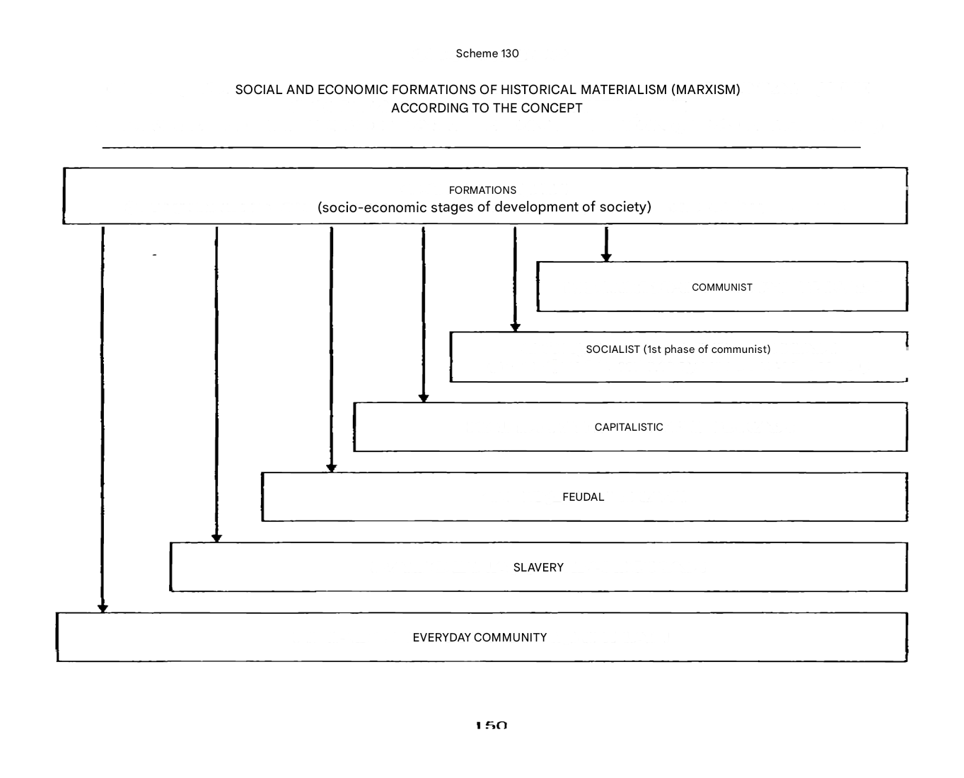

Slide 10
2. The multilinear development is substantiated by the German philosopher and historian Karl Jaspers (1883-1969) and the German philosopher and sociologist Max Weber (1864-1920).
K. Jaspers presented the entire historical process with the following scheme: 1) prehistory - or "Promethean" era (the origin of speech, tools, the ability to use fire), when man just becomes man; 2) the existence of great cultures of antiquity (ancient Indian, ancient Chinese, ancient Egyptian, Aztecs, etc.); 3) axial time – a modern person is fully formed; 4) the scientific and technological era, which now has a transformative effect on the world and man and, possibly, will lead to a new axial time.
The Axial Time, which began about 500 years B.C., is characterized by a sharp intellectual outburst, which led, as it were, to a turn in the axis of history.

Slide 11
The essence of the turn: a) a person has become aware of the infinity and horror of the world around him and his own helplessness;
b) a person discovered in himself what later became known as a personality;
c) a person has realized that he can refuse the benefits of coexistence, seclude himself (go to the mountains, deserts) and, having become a hermit, see the light, comprehend the wisdom of the universe, its laws and bring this knowledge to people;
d) a person felt time; His historical consciousness awoke and it seemed to him that he was living at the very end of history.
It was during this period, almost simultaneously in China, India, and Greece, that philosophical schools arose and great thinkers appeared. in China - Confucius, Lao Tzu; in India - Buddha; in Iran, Zarathustra; to Greece – Thales, Parmenides, Democritus, Heraclitus.
For Jaspers, history is the result of the creativity of individuals. There can be no history outside the personality. Peoples who did not accept the ideas of the Axial Age remained, as it were, on the "outskirts" of history. They develop or degrade very slowly - "sleep".
In this sense, the development of society, according to Jaspers, is multilinear, and human history is a kind of pulsation.

Slide 12
3. Cyclic development is characterized by the understanding of history as historical events that take place in a certain rhythm and are as if repeated.
There are several types of cyclicity:
a) pendulum-like; b) circular; c) spiral; d) wave (sinusoidal). The type depends on the size and scope of the social system: in small ones, pendulum cycles (family) predominate; in the middle - circular and spiral; in large ones – circular and long-wave.

Slide 13
2. Sources, subjects, driving forces of the historical process.

Slide 14
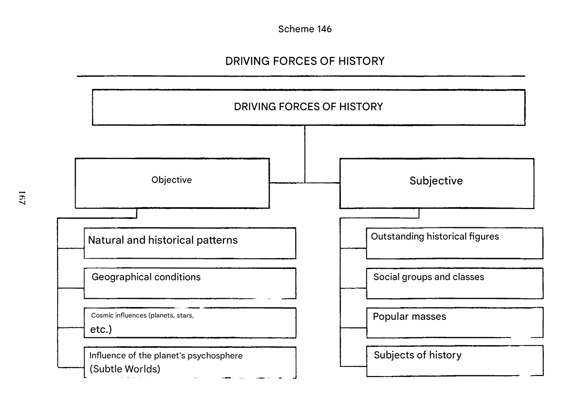

Slide 15
Objective factors:
1) natural and climatic conditions of society; 2) the state of material production; 3) the existing social structure of society; 4) people's needs to provide the necessary conditions for life and interests, which are the main stimulus of human activity.
Subjective factors: a) consciousness, the spiritual world of people; b) ability and skills for productive activity; c) social experience; d) the level of culture; e) organizational, volitional qualities; g) organization in people's actions.
Thus, subjective factors are various kinds of abilities of people to make changes in certain aspects of social life by their actions

Slide 16
3. The Concept of Social Progress and the Problem of Its Criteria

Slide 17
Progress (from the Latin "rogressus" - movement forward) is a direction of development that is characterized by a transition from the lower to the higher, from the less perfect to the more perfect.
Social progress means, in the most general definition, the movement of society forward, from less perfect to more perfect ways and forms of life activity

Slide 18
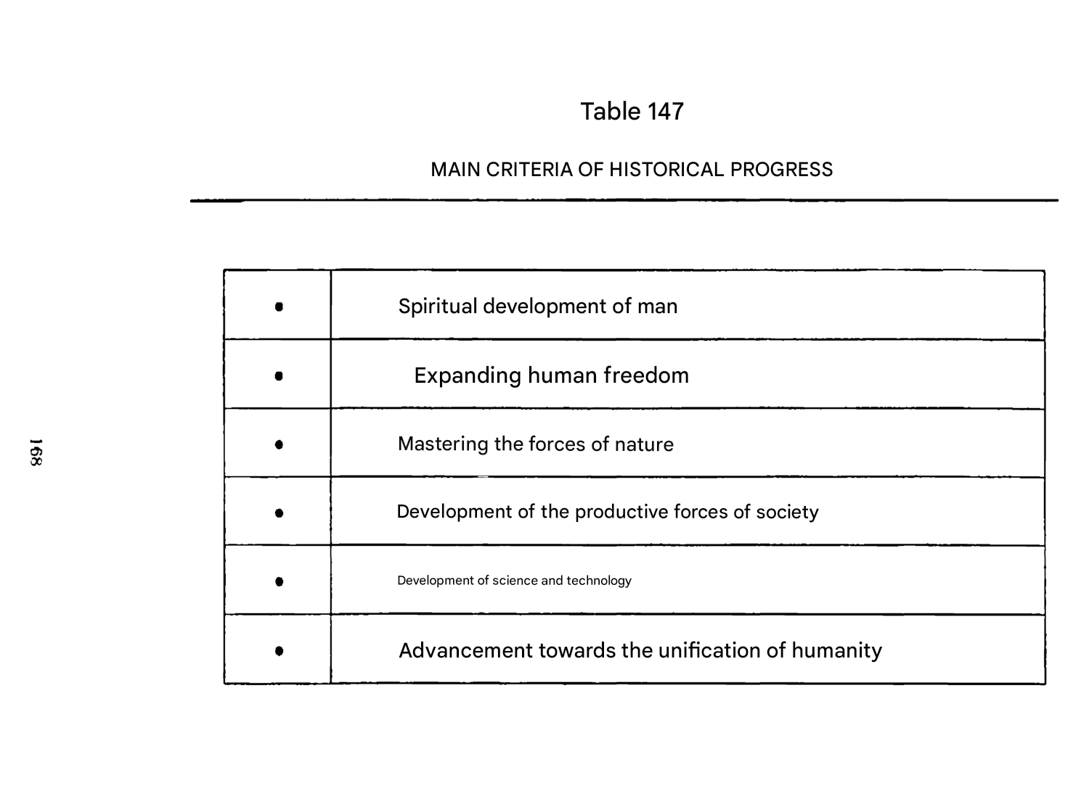

Slide 19
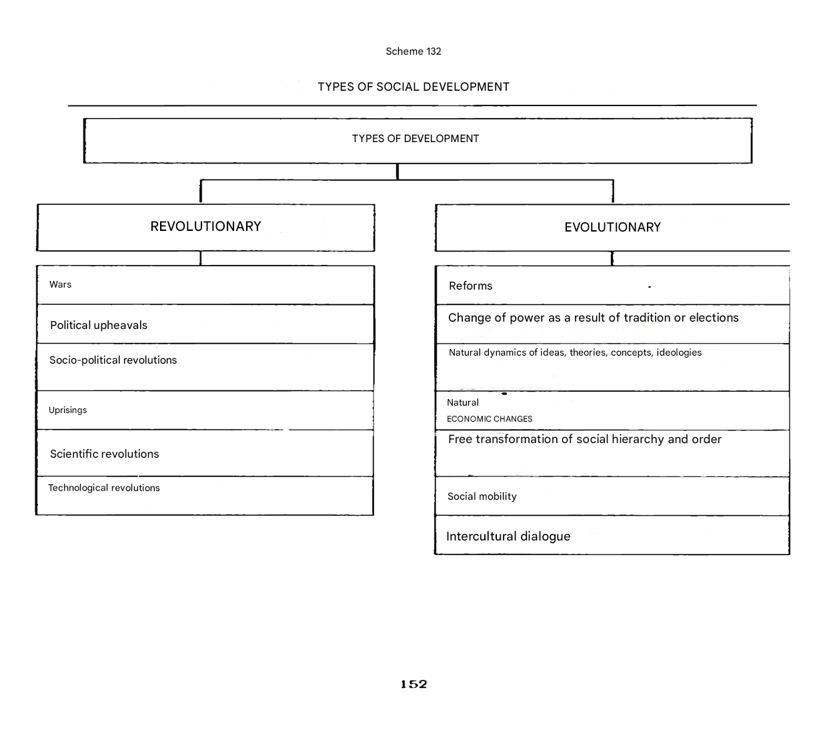

Slide 20
4. Unity and diversity of world history. Formations and civilizations

Slide 21
There is no unity in the understanding and explanation of the historical process. All existing views can be reduced to two points of view. 1. History is a single integral process of development of human society, with the allocation of certain stages, stages that distinguish one period of development from another.
2. History is a pluralistic (diverse) process of emergence, coexistence and isolated development of individual countries, regions, civilizations.

Slide 22
The first point of view, which can also be called systemic, is dominant (predominant), although it was defended by supporters of different trends in philosophy. a) From a religious point of view, the unity of the historical process is based on the principles of providentialism, according to which the divine will directs history towards a predetermined goal.
b) From the point of view of the Enlightenment thinkers, the unity of history in the objective nature of the laws of the development of society by analogy with the laws in nature. c) From the point of view of idealists, the unity of the historical process was deduced from the existence of a single idea, the Absolute Spirit, consciousness or thought. d) Materialists deduced the unity of history from the objective nature of economic and social laws inherent in various socio-historical systems, countries, states, and civilizations.

Slide 23
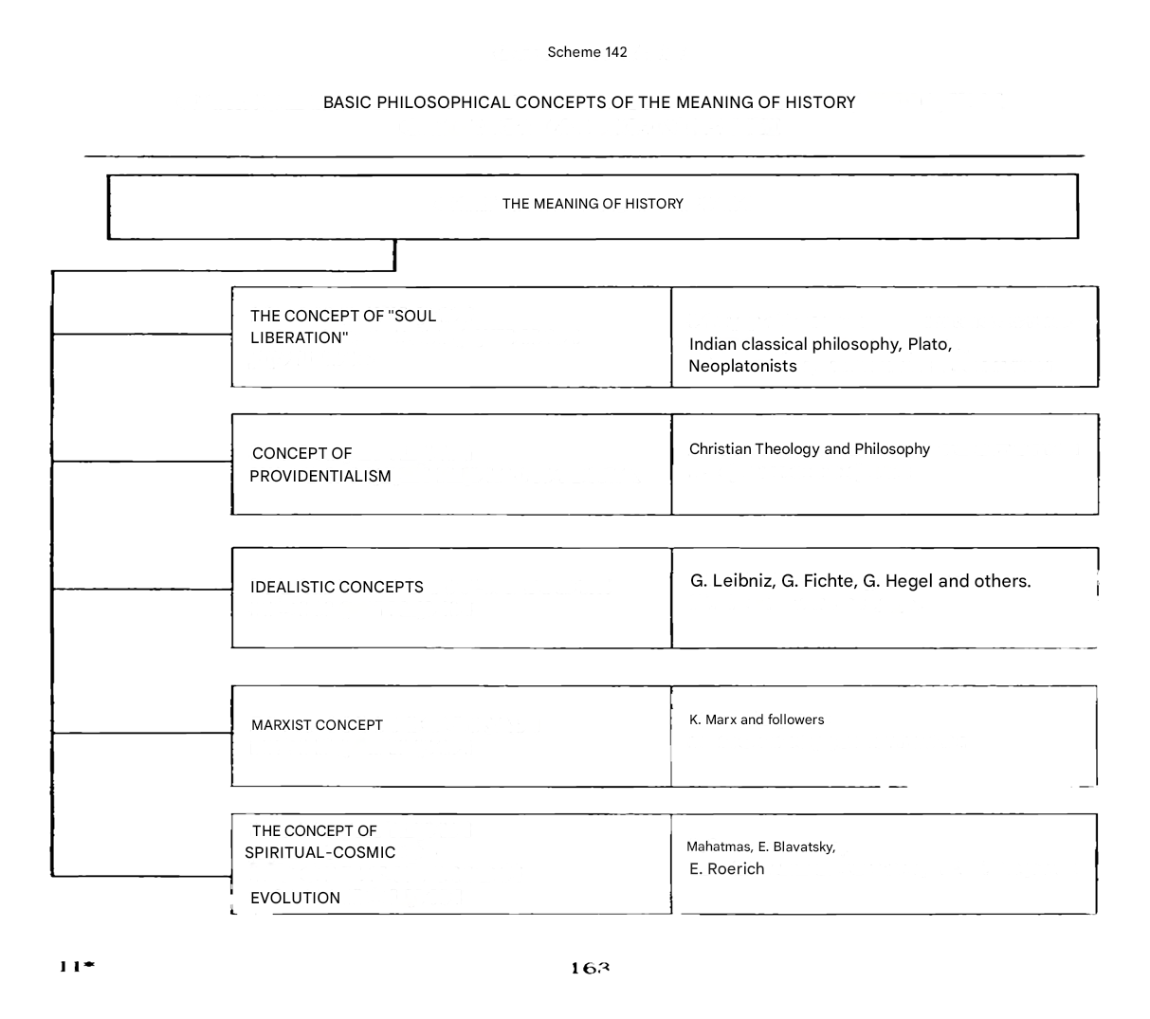

Slide 24
The second point of view, pluralistic, was formed much later. Its supporters argue that there is no history as a single process. Specific societies (united in countries, states, civilizations) arise, grow and develop, reach prosperity and disappear without exerting any influence on each other.
In this case, the whole of history turns into a set of socio-historical formations isolated from each other, which means that it is impossible to single out any stages or epochs in history. The pluralistic approach excludes the development of human society on a planetary scale and, consequently, excludes the unity of the historical process

Slide 25
